Slide 1

Visualizing Uncertainty with Chromatic Aberration
MCSc Thesis Defence
Rashidul Islam
10 May 2022

Slide 2
Contents
Background
Work Detail
User Study Design
Quantitative Test
Conclusion
Future Work

Slide 3
Background

Slide 4
What is Uncertainty?
In practice, uncertainty is defined as doubt about something.
In digital world, uncertainty refers to imperfect, unknown, lack of sureness or certainty in information.

Slide 5
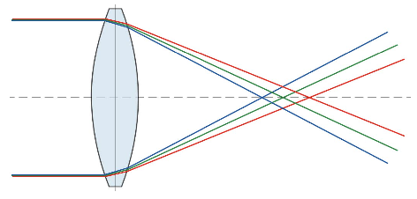
What is Chromatic Aberration?
Chromatic aberration is an effect that occurs when a lens is not able to properly refract all the wavelengths of colour in the same point.
We call Chromatic Aberration as CA throughout the talk.
Light refraction at different angles

Slide 6

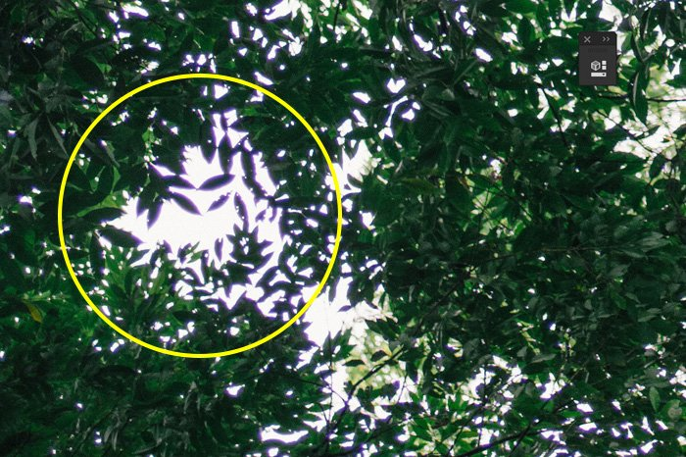
Examples of CA
Real World Chromatic Aberrations

Slide 7
Work Details

Slide 8
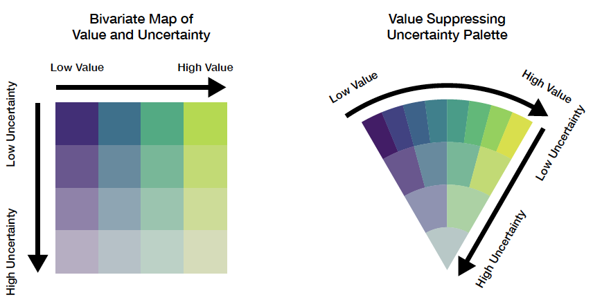
Prior Work
Bivariate Map
VSUP (Value Suppressing Uncertainty Palettes)

Slide 9
Uncertainty Data Generation Flow
Training Data
Forecasting Algorithms
Model
After Training
New Data (Optional)
Model
Predictions
Calculate Uncertainty
Data with Uncertainty

Slide 10
Predictive Algorithms
MLP (Multilayer Perceptron)
CNN (Convolutional Neural Network)
LSTM (Long-Short Term Memory)
Auto Arima

Slide 11
Uncertainty Comparison among Models
Country | MLP | CNN | LSTM | ARIMA
United States | 7.00 | 7.00 | 3.44 | 7
India | 4.28 | 0.61 | 7.00 | 3.52
Brazil | 3.64 | 0.51 | 3.24 | 1.27
Kazakhstan | 2.43 | 0.42 | 0.35 | 0.17
France | 2.15 | 0.31 | 0.81 | 0.56
Peru | 1.28 | 0.23 | 0.28 | 0.22
Germany | 1.21 | 0.19 | 0.50 | 0.51
Spain | 1.07 | 0.19 | 0.67 | 0.33
Turkey | 1.03 | 0.19 | 1.21 | 0.30
Argentina | 1.02 | 0.14 | 1.08 | 0.25

Slide 12
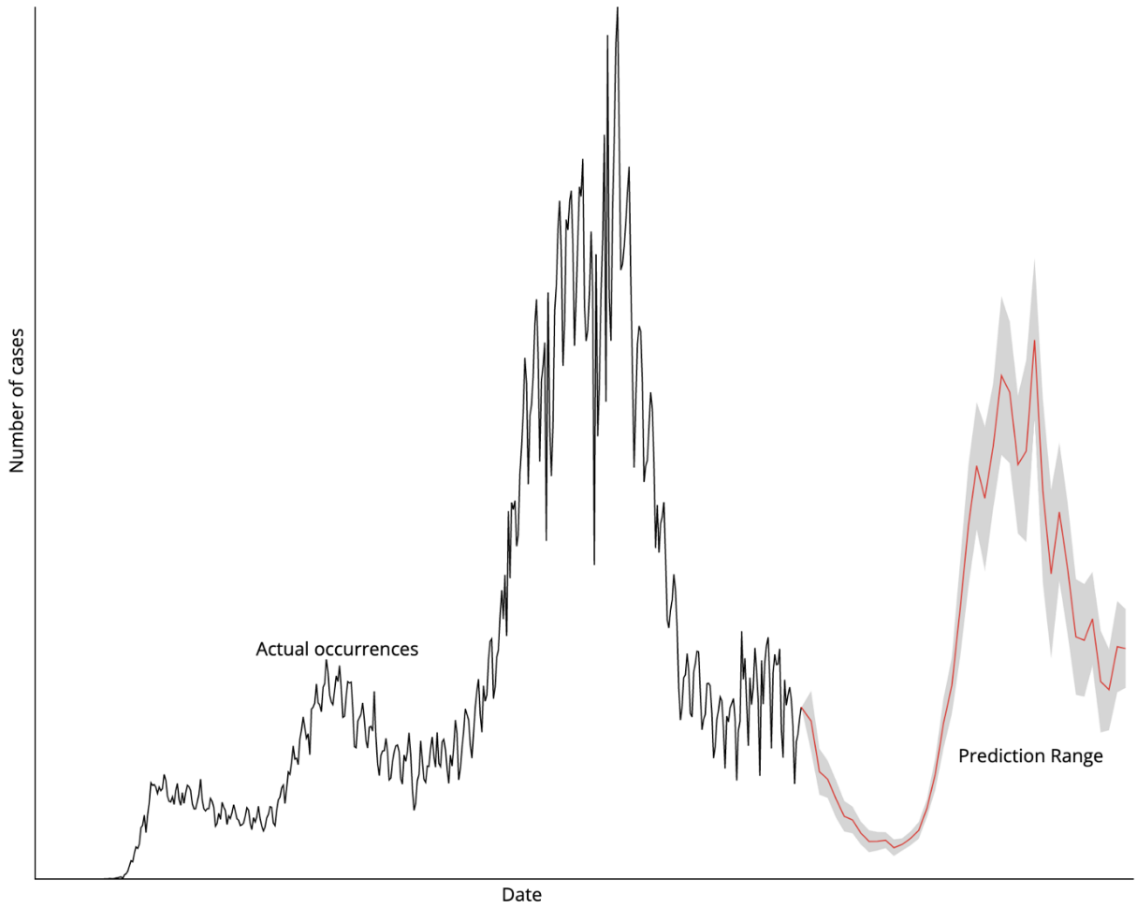
Uncertainty in Prediction

Slide 13
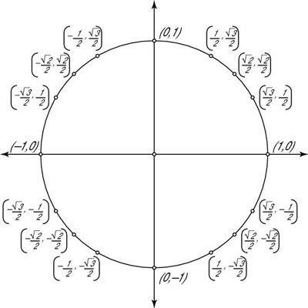
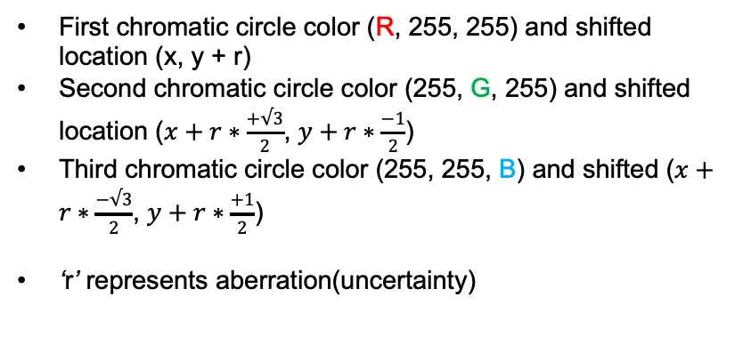
Architecture of CA
First chromatic circle color (R, 255, 255) and shifted location (x, y + r)
Second chromatic circle color (255, G, 255) and shifted location ($x+r∗\frac{+√3}{2}$, $y+r∗\frac{−1}{2}$)
Third chromatic circle color (255, 255, B) and shifted ($x+r∗\frac{−√3}{2}$, $y+r∗\frac{+1}{2}$)
‘r’ represents aberration(uncertainty)
(x, y)

Slide 14


CA on a Circle
Three overlapping circles filled by rgb (100, 255, 255), rgb (255, 149, 255), rgb (255, 255, 180)
Used mix-blend-mode to darken

Slide 15
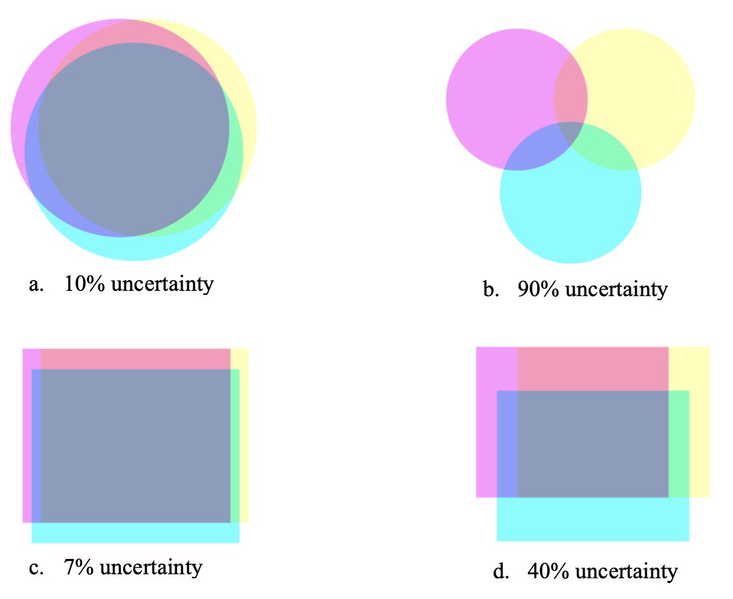
More Examples of CA Shapes

Slide 16
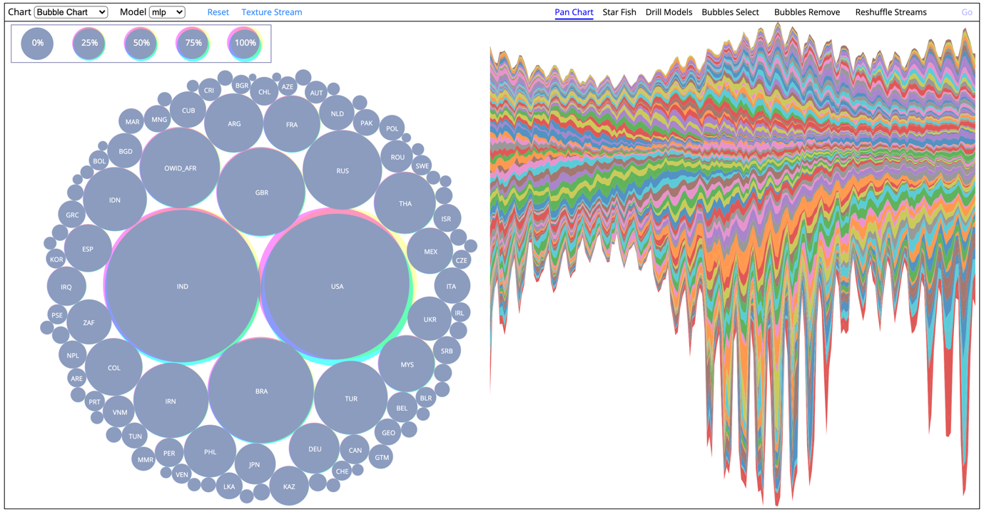
Web Interface

Slide 17
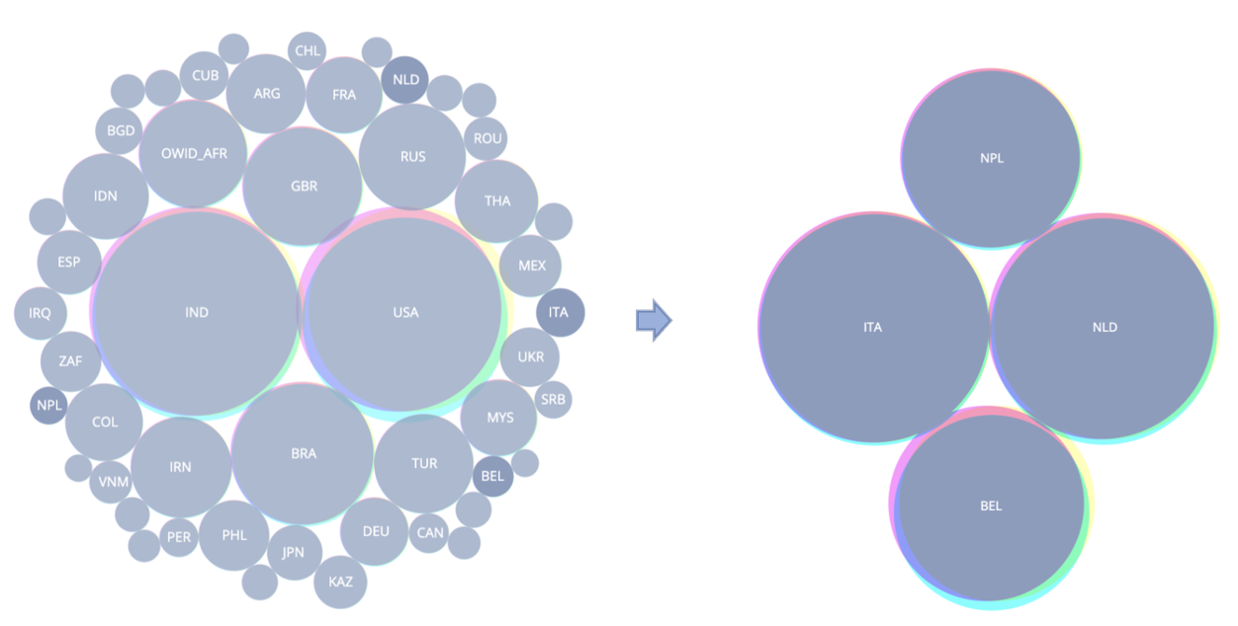
Filtering
By selected country of interest
Side by side comparison

Slide 18
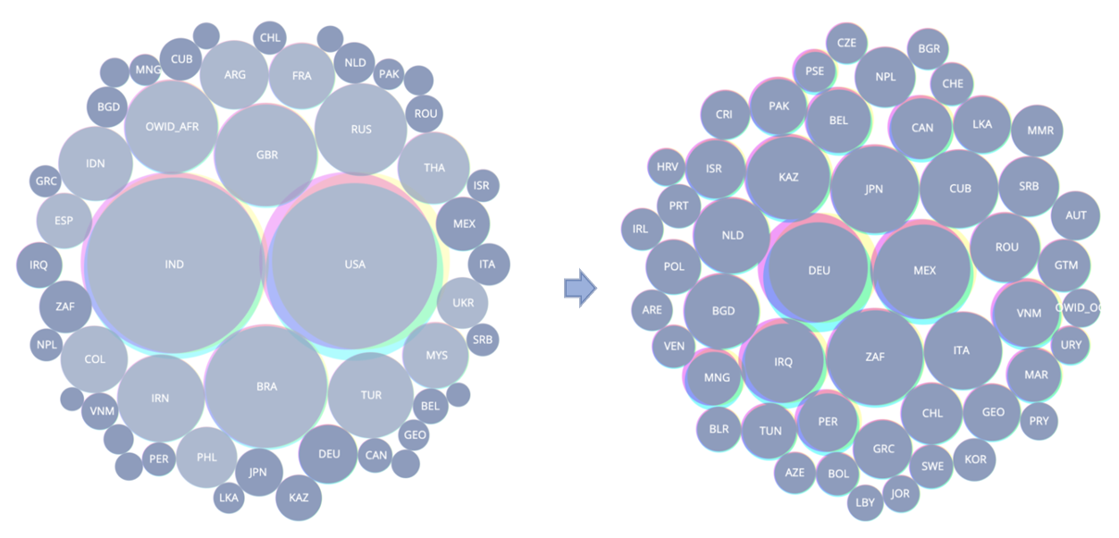
Filtering
Remove countries of interest
Comparison among rest of the countries

Slide 19
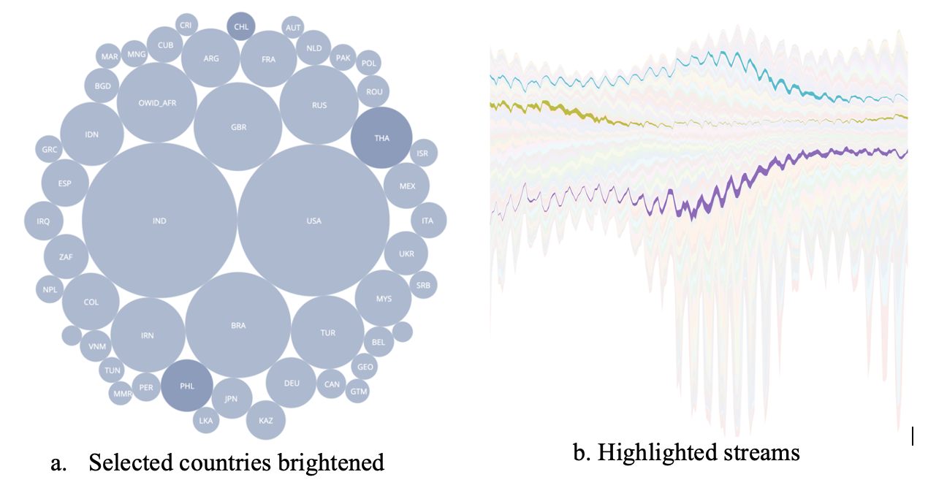
Reshufling Streams
Highlighted selected countries

Slide 20
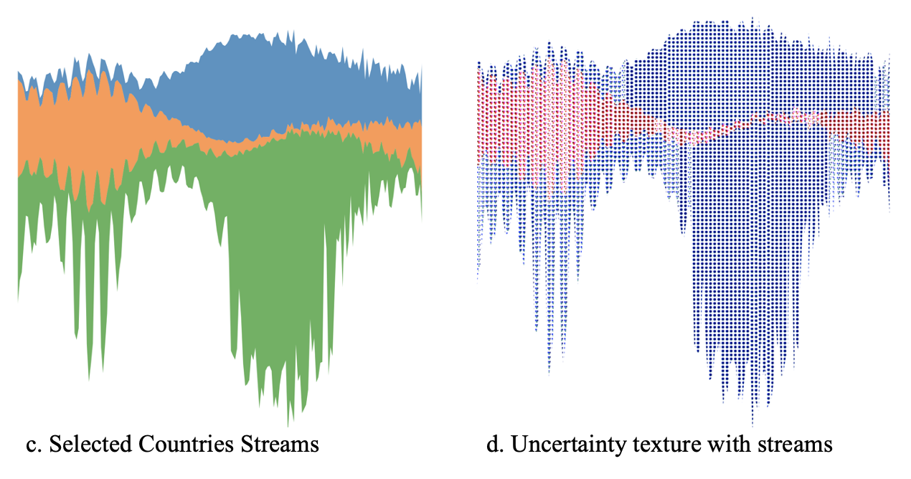
Reshufling
Side by side uncertainty comparison among three selected countries.

Slide 21
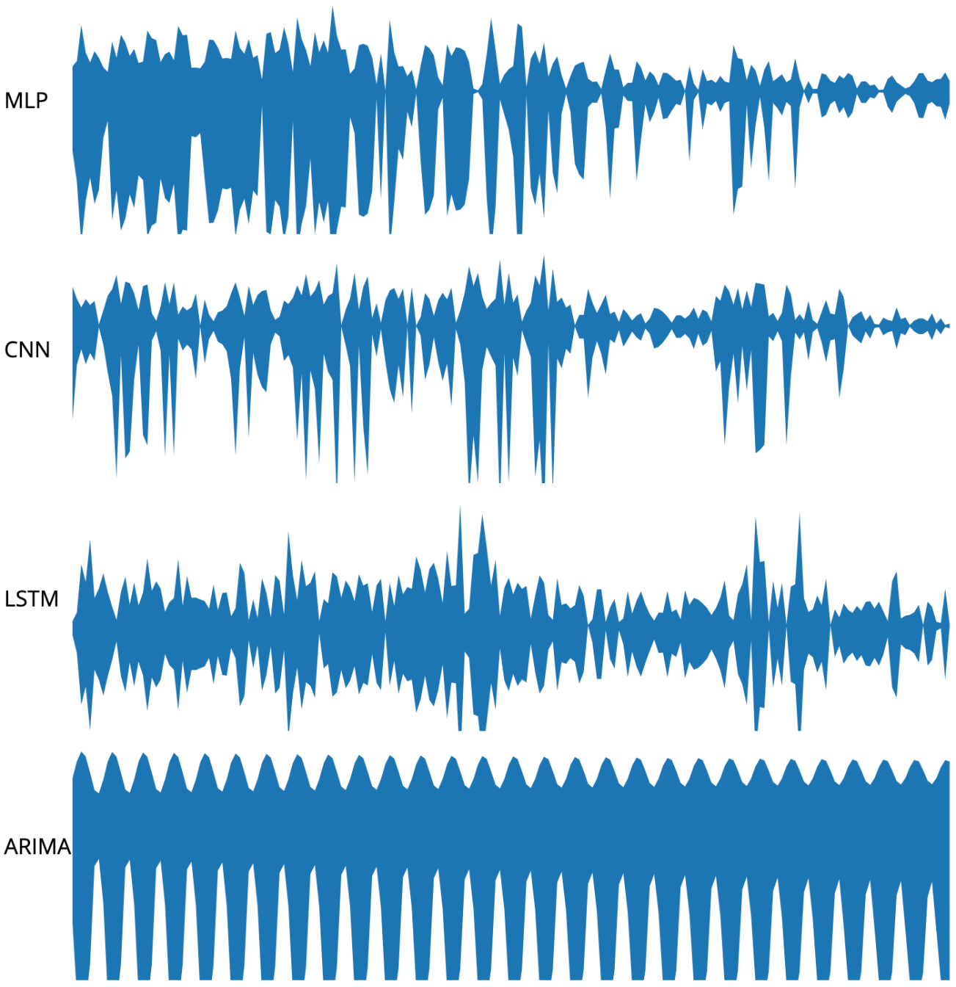
Drill-down
Prediction streams for Brazil with four models.

Slide 22
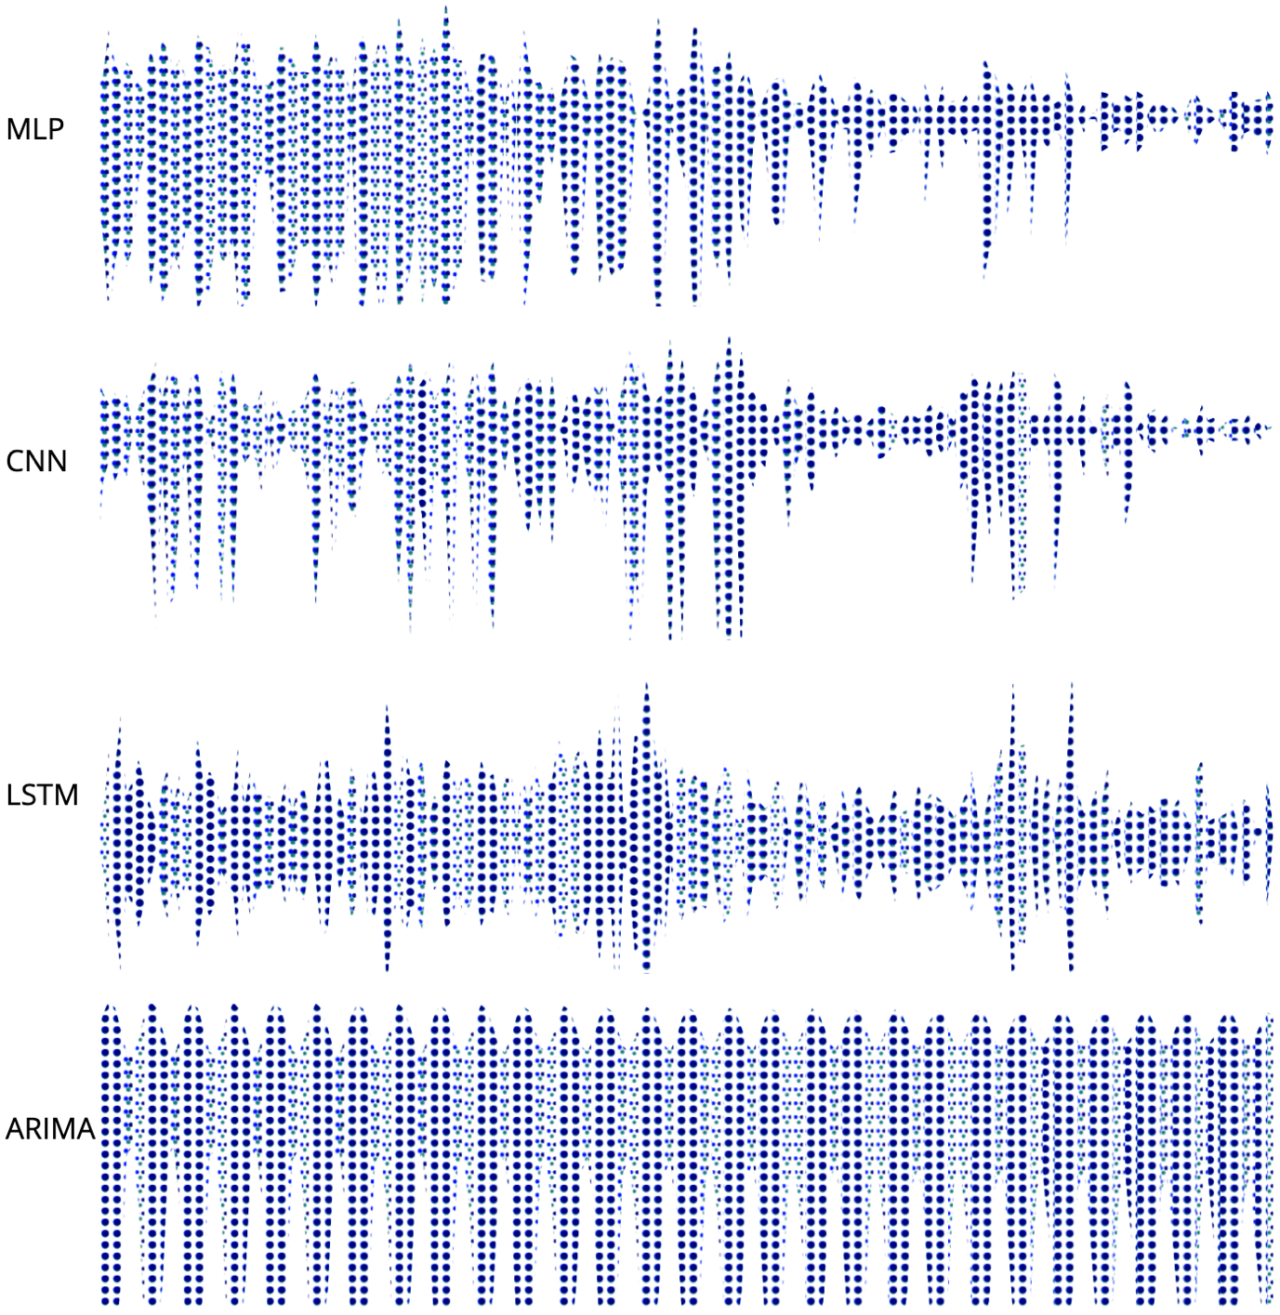
Drill-down
Side by side uncertainty comparison among four model predictions

Slide 23
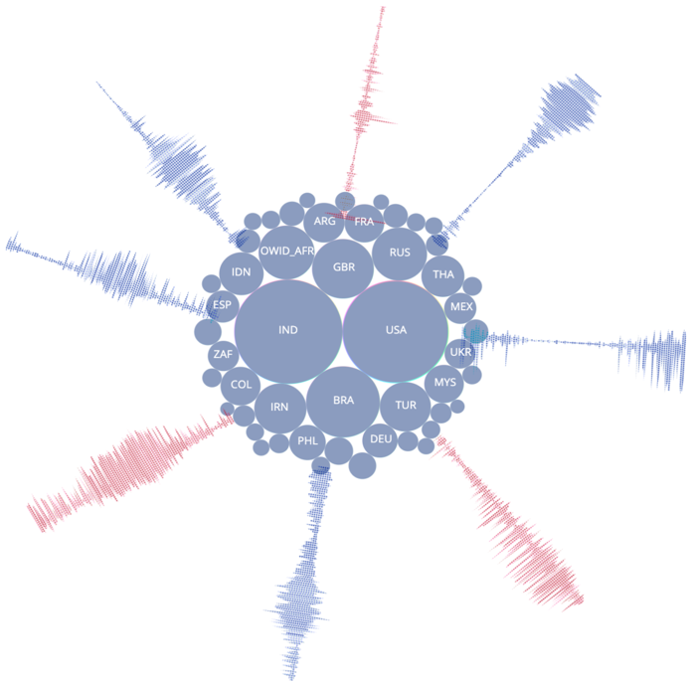
Star-Fish Layout
Side by side uncertainty comparison among four model predictions

Slide 24

Streamgraph
Flow of number of new cases for a country.
From perdiction data of a certain period of time.

Slide 25
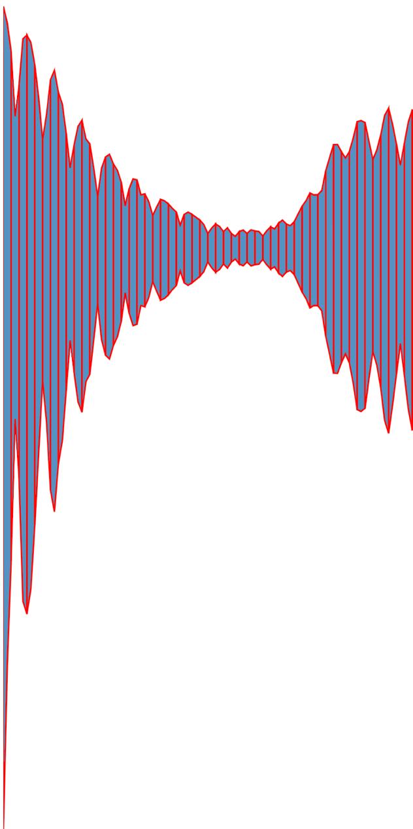
Streamgraph Slicing
Averaging every three consecutive days.

Slide 26
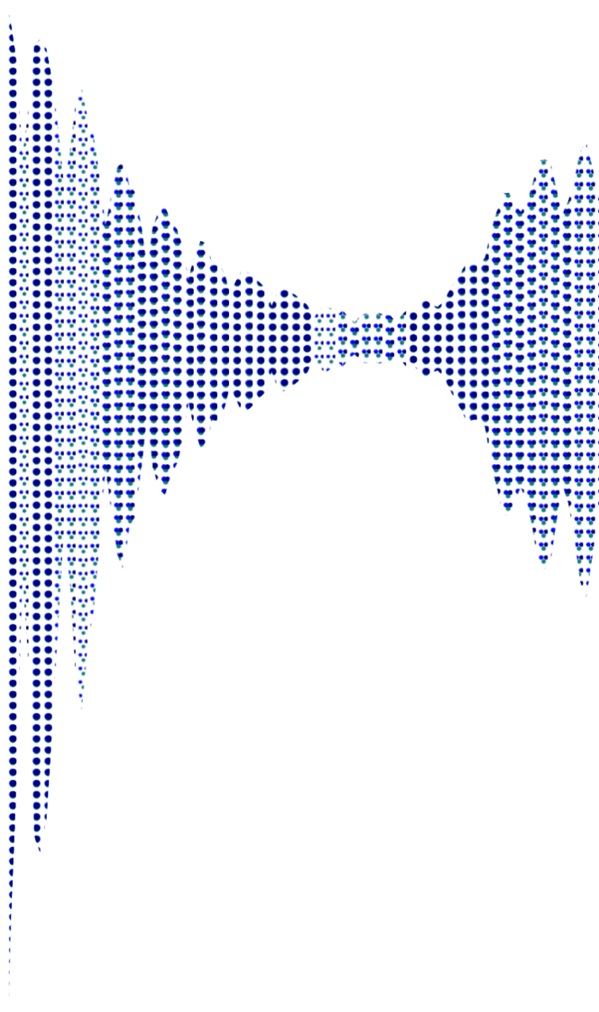
Streamgraph with CA
Assigning texture pattern to every slice.
Every slice has different amount of uncertainty (CA).

Slide 27
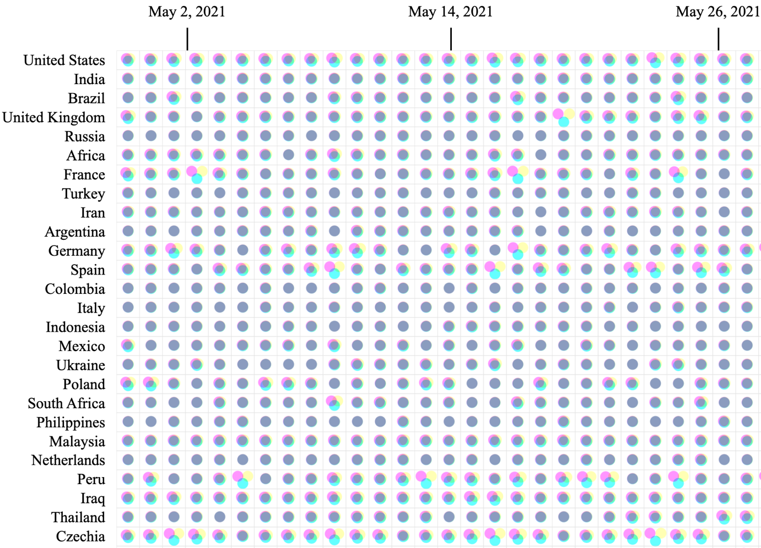
Circle Grid Chart
Each cell represents a certain amount of CA in the scale range of 1-9.
Size of circles are same by considering counts are same.

Slide 28
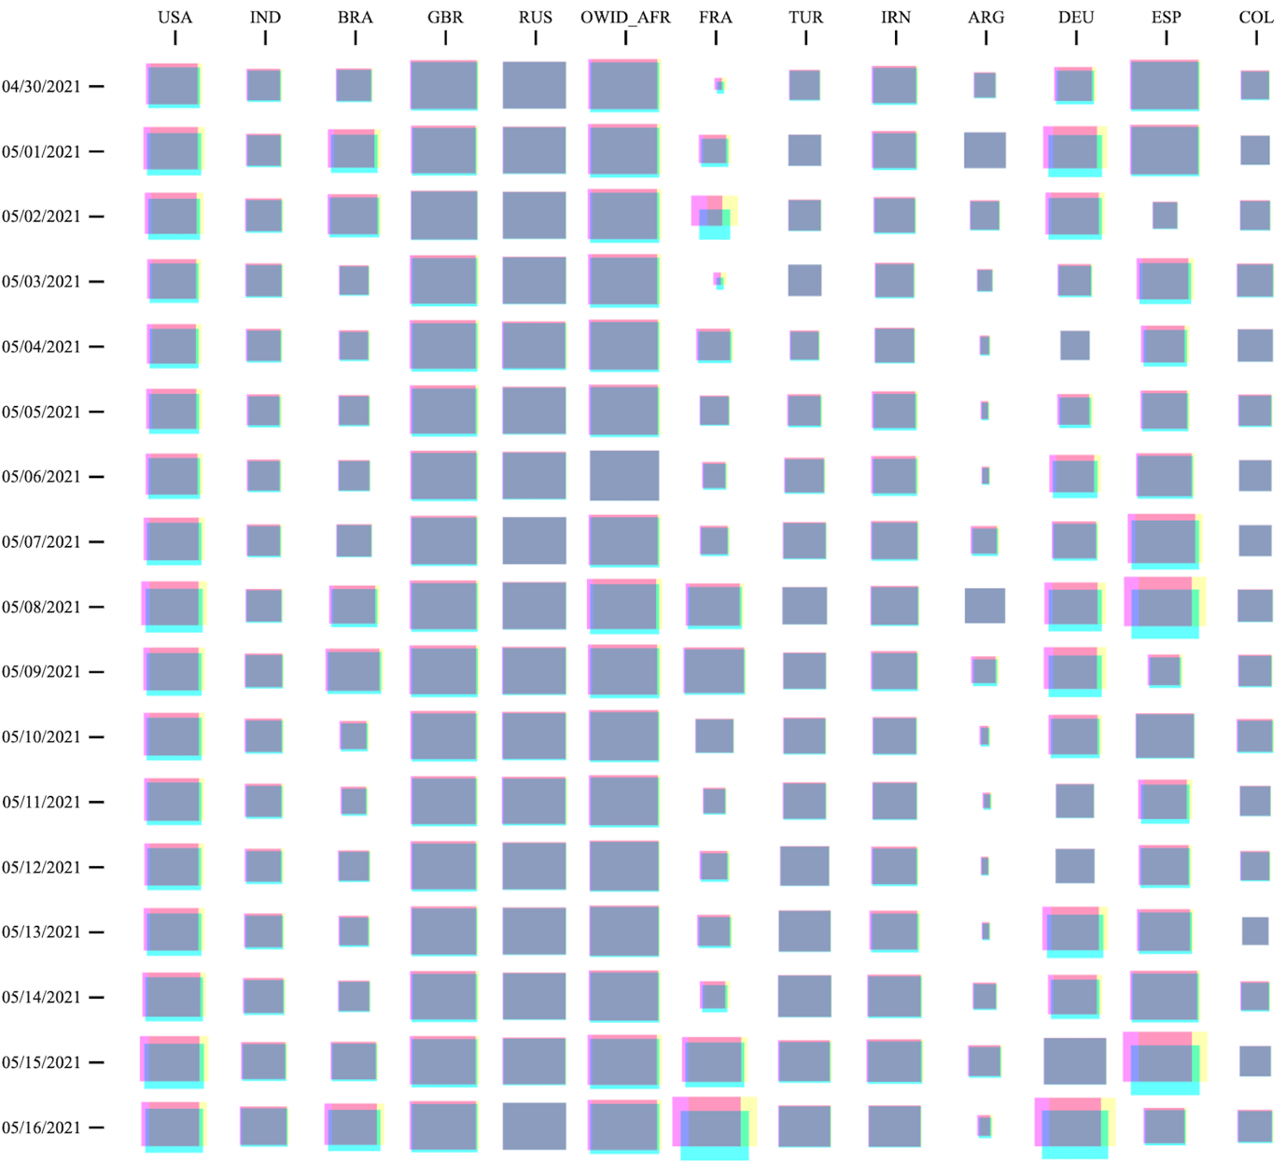
Square Grid Chart
Each cell represents a certain amount of CA in the scale range of 1-9.
Count is represented by size.

Slide 29
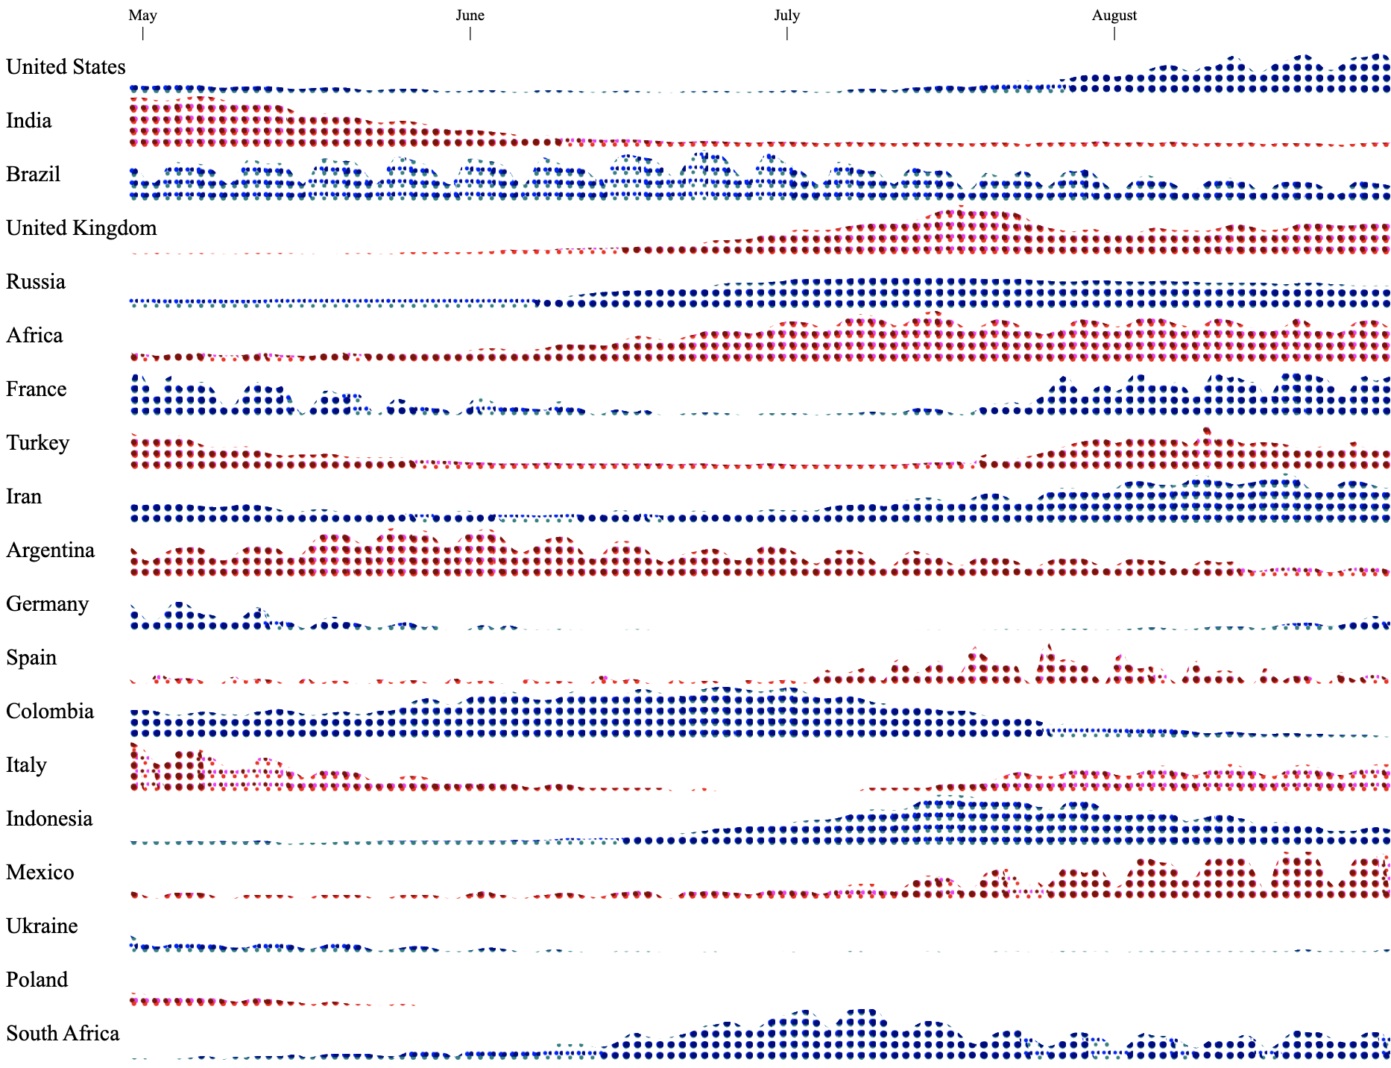
Horizontal Chart
Every country is kind of stream graph.
Every 3 consecutive days refers to a column

Slide 30
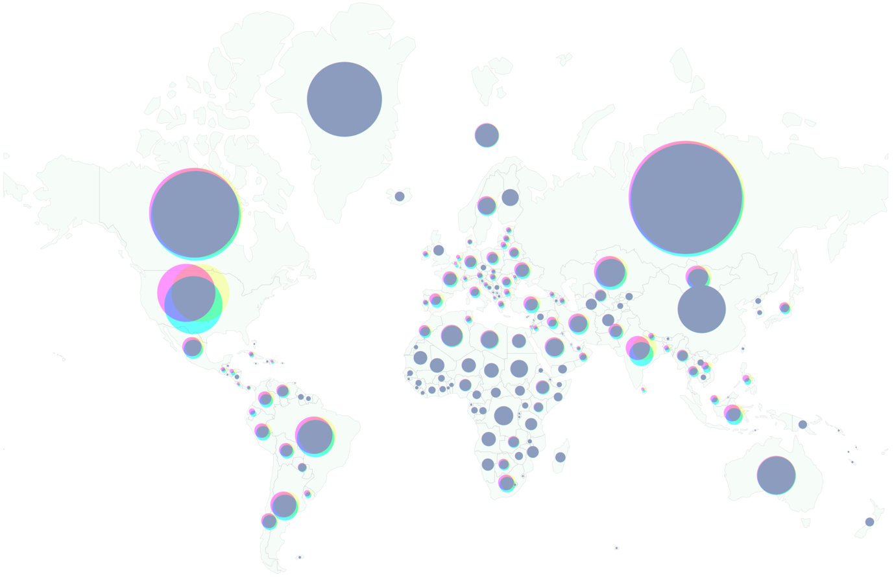
World View

Slide 31
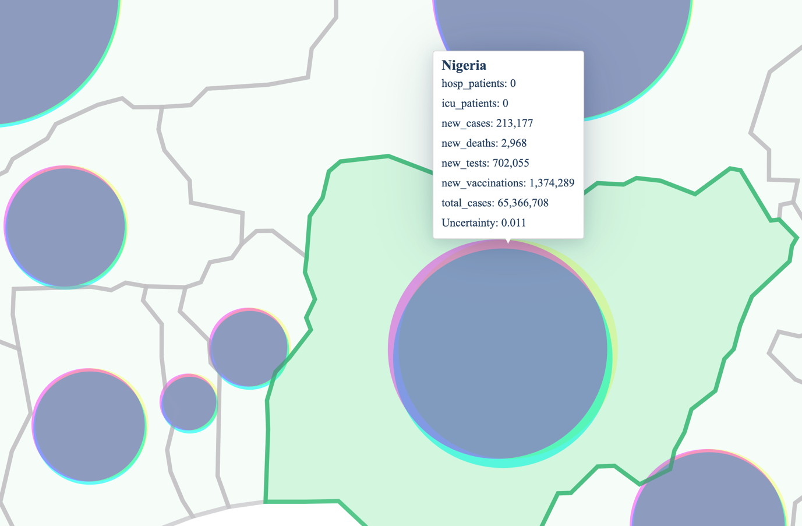
Zoomed view

Slide 32
User Study

Slide 33
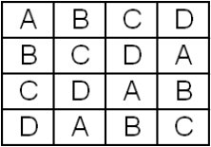
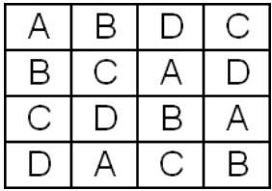
Counter Balancing
Latin Square Balanced Latin Square

Slide 34
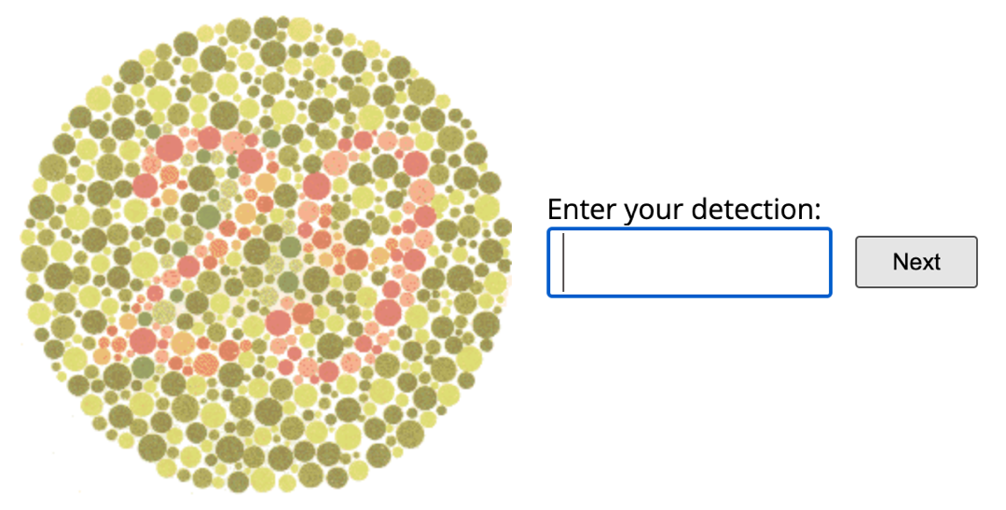
Color Blindness Test

Slide 35
Components of the Study
CA + Bubble
CA + Grid
VSUP + Bubble
VSUP + Grid

Slide 36
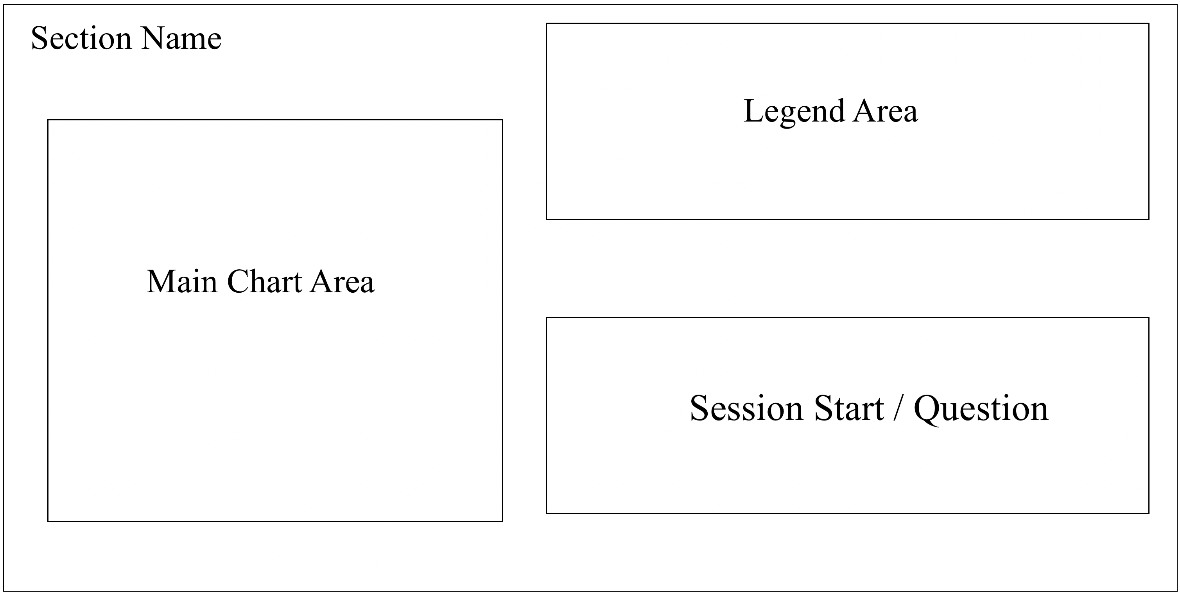
Questionnaire Layout

Slide 37
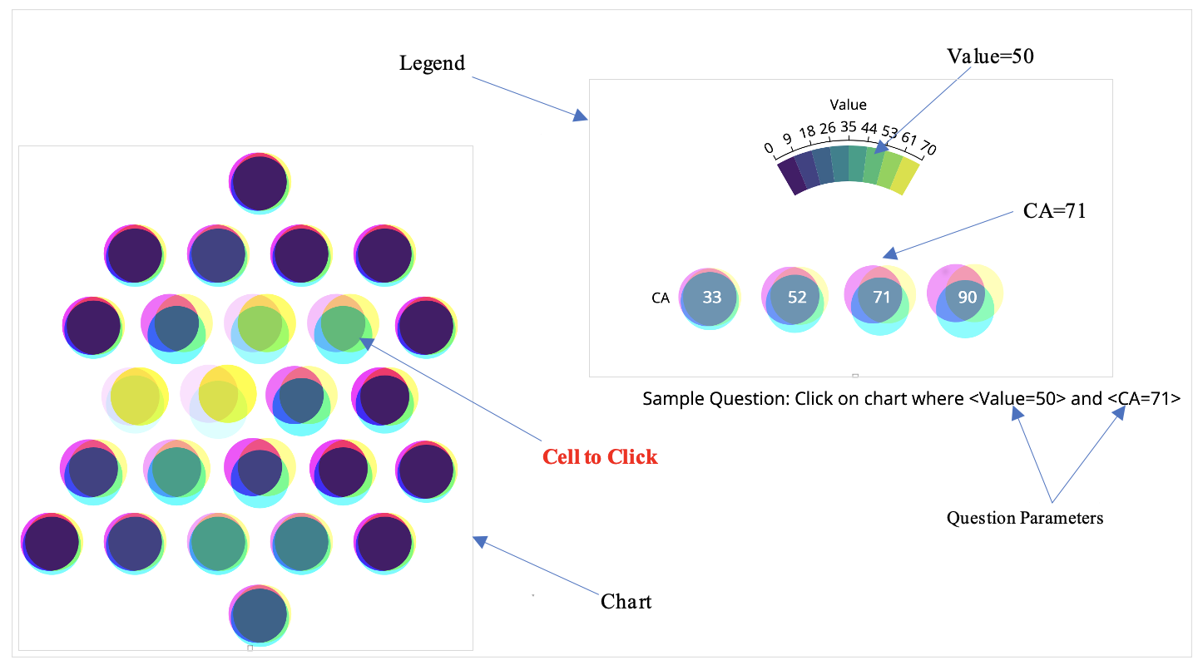
CA + Bubble

Slide 38
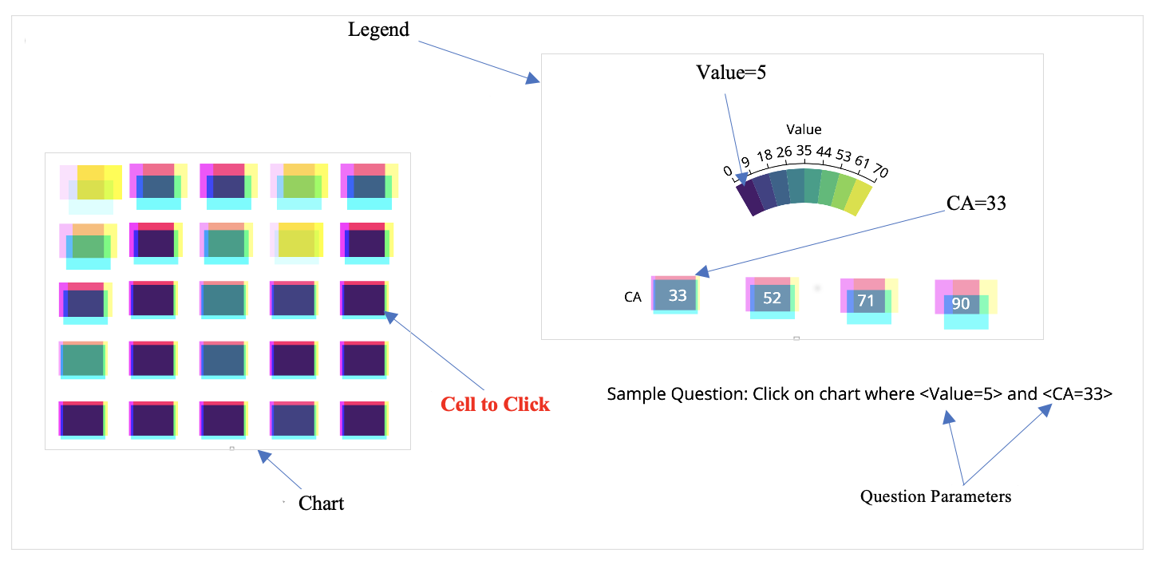
CA + Grid

Slide 39
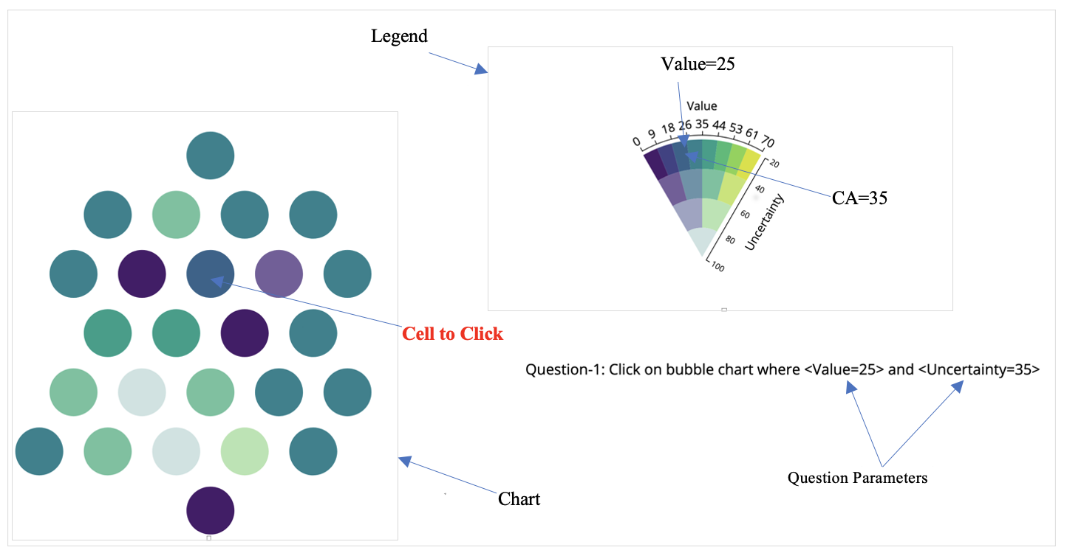
VSUP + Grid

Slide 40
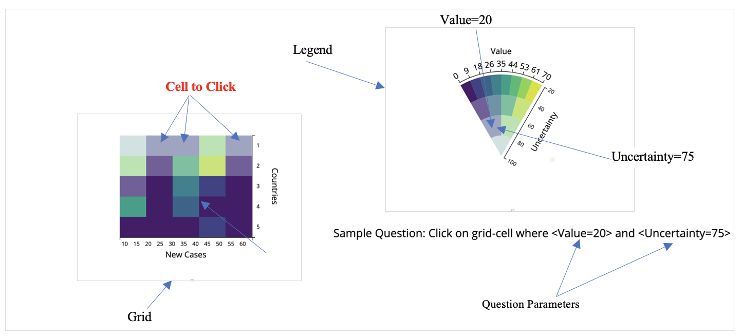
VSUP + Grid

Slide 41
Type of Questions
Single Parameter and Single Answer
Single Parameter and All Answer
Double Parameters

Slide 42
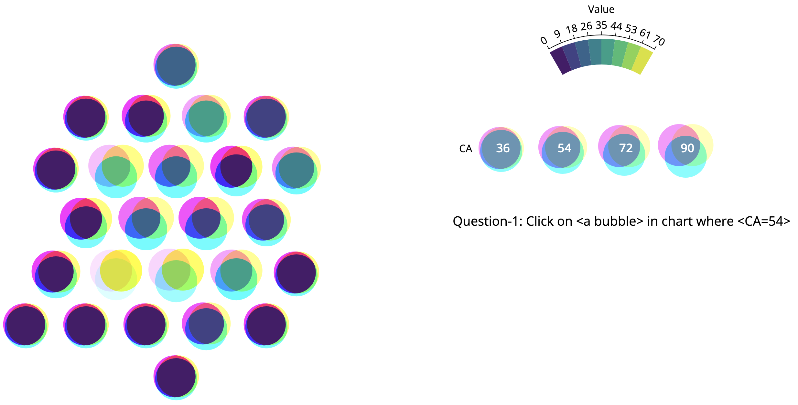
Single Parameter Single Answer

Slide 43
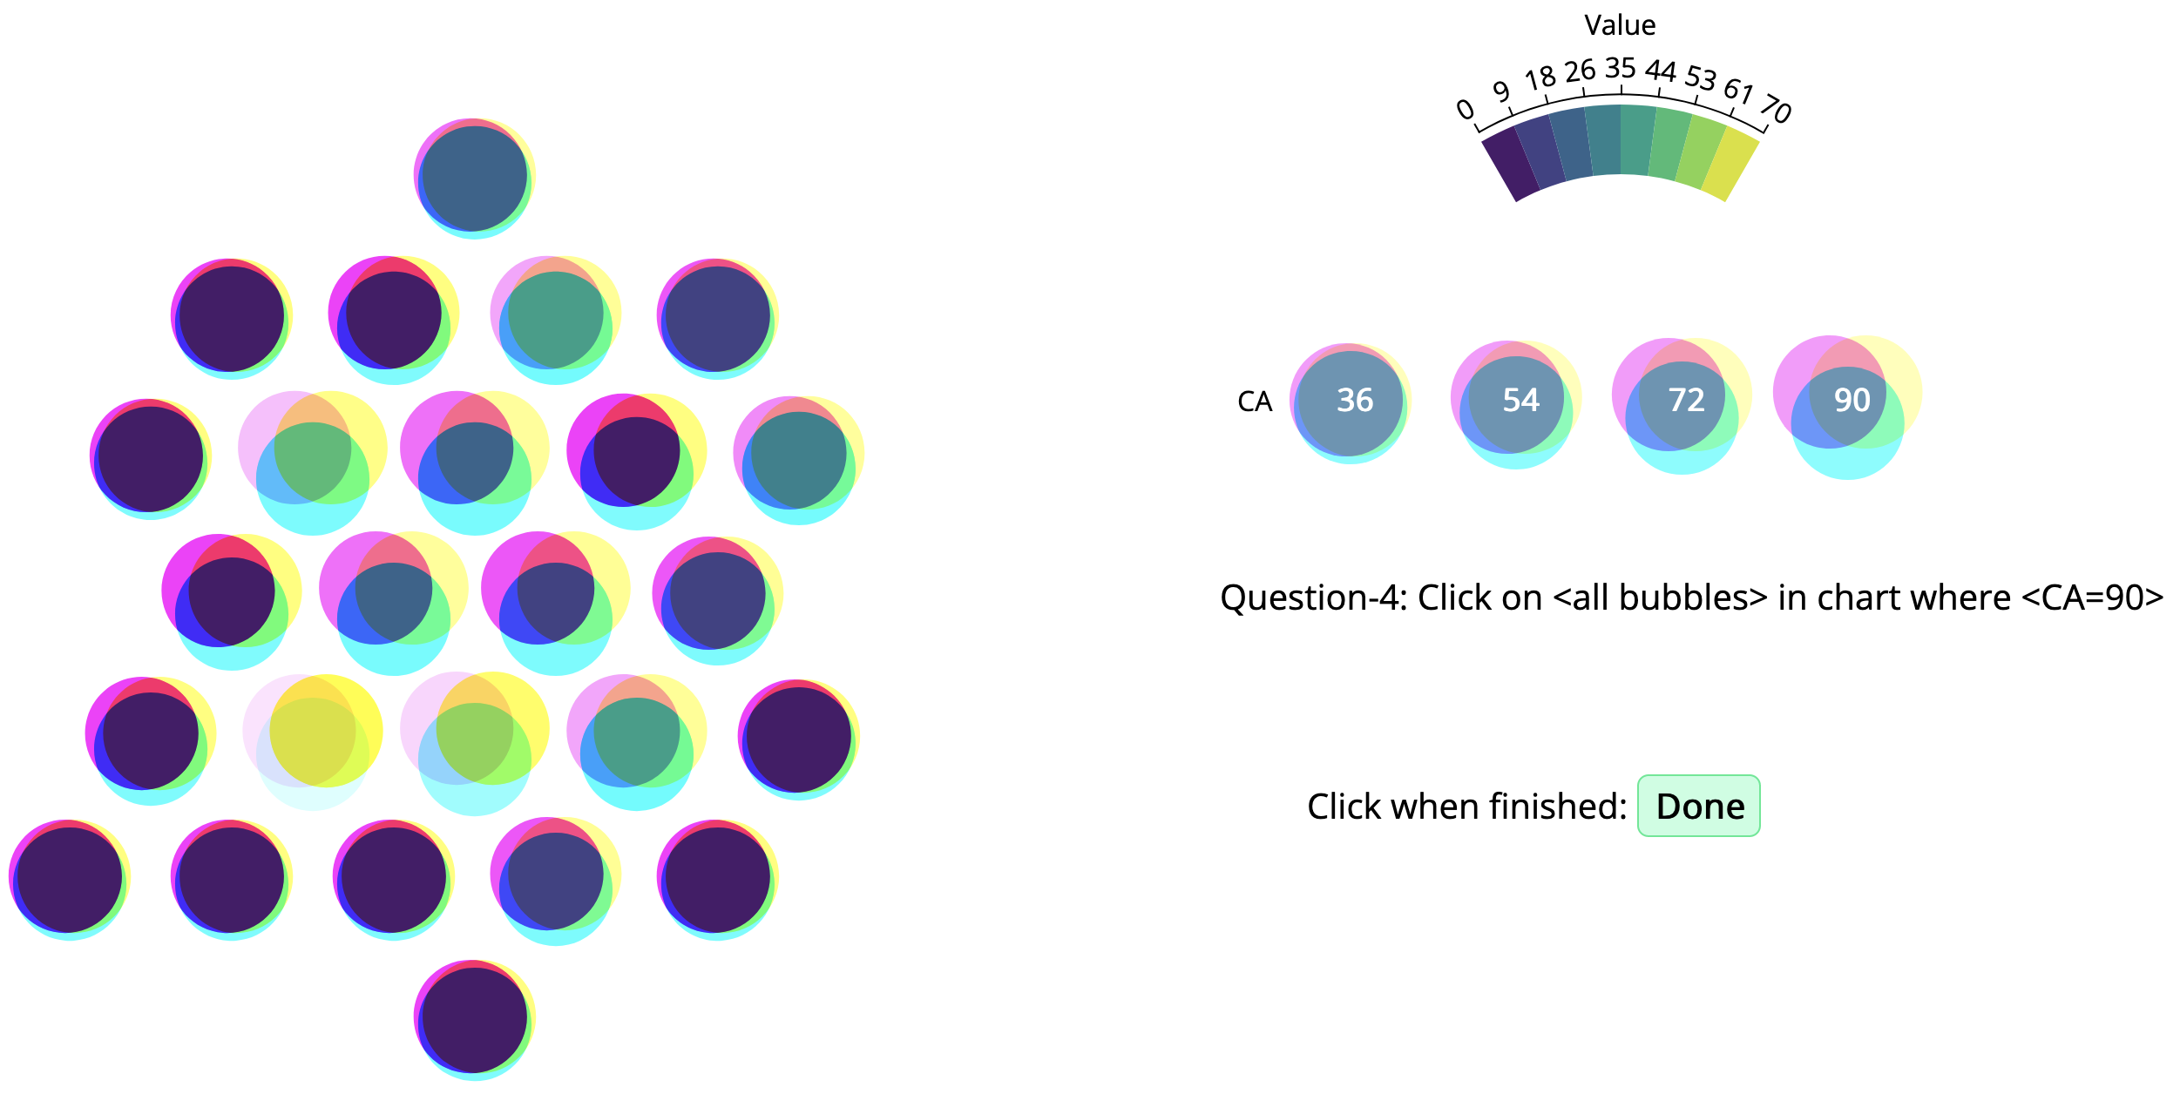
Single Parameter All Answers

Slide 44
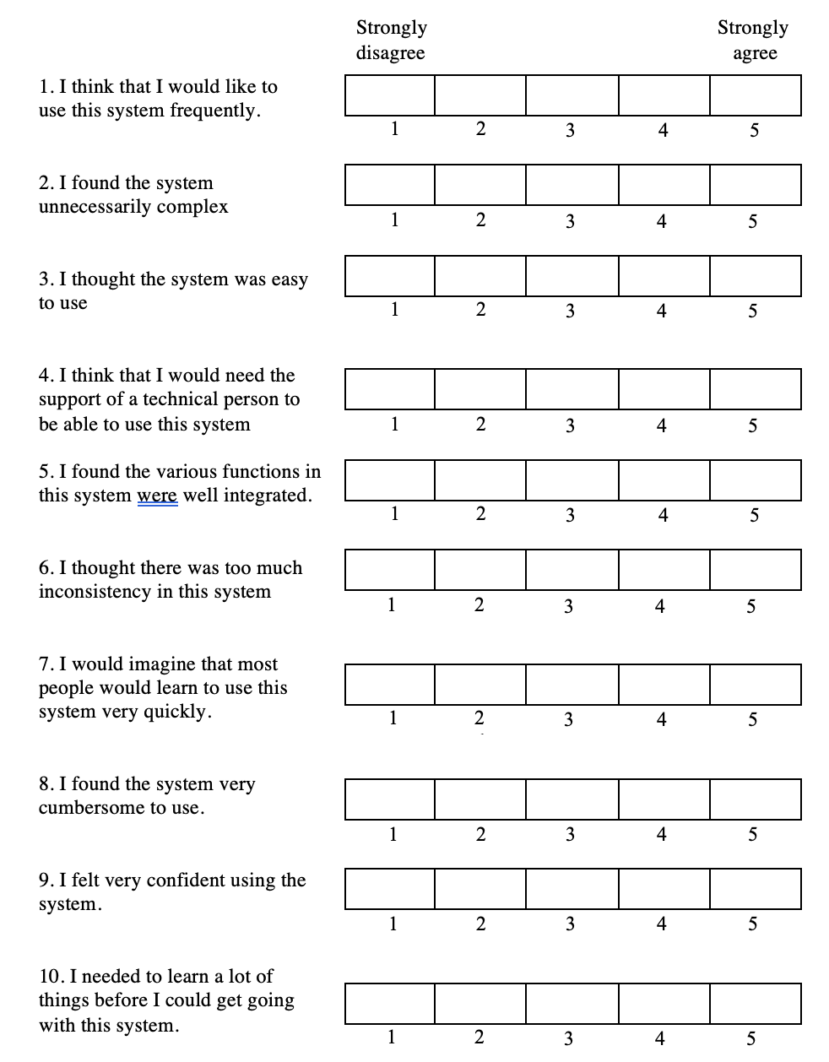
SUS Questions

Slide 45
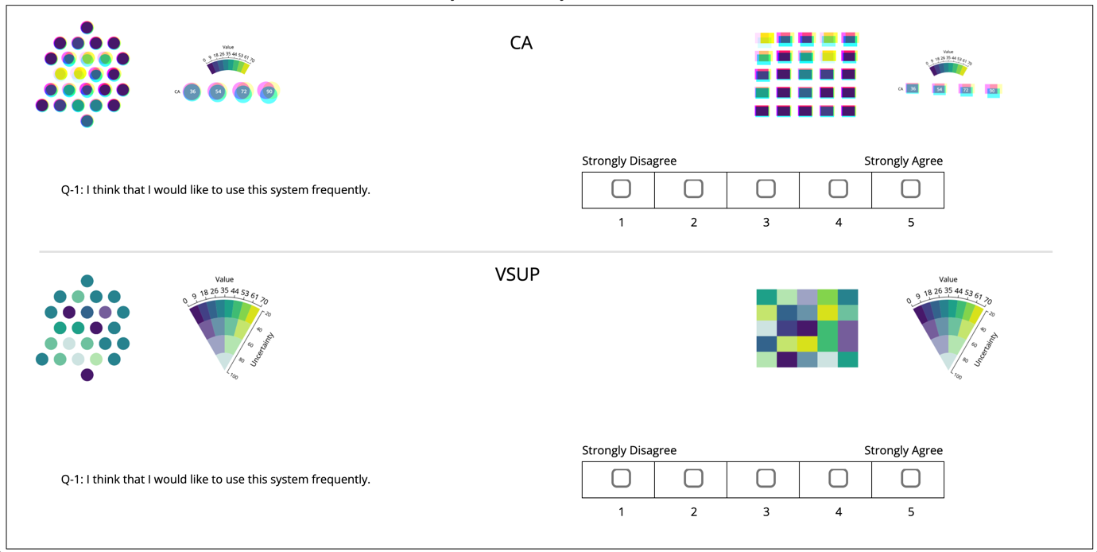
SUS Question Interface

Slide 46
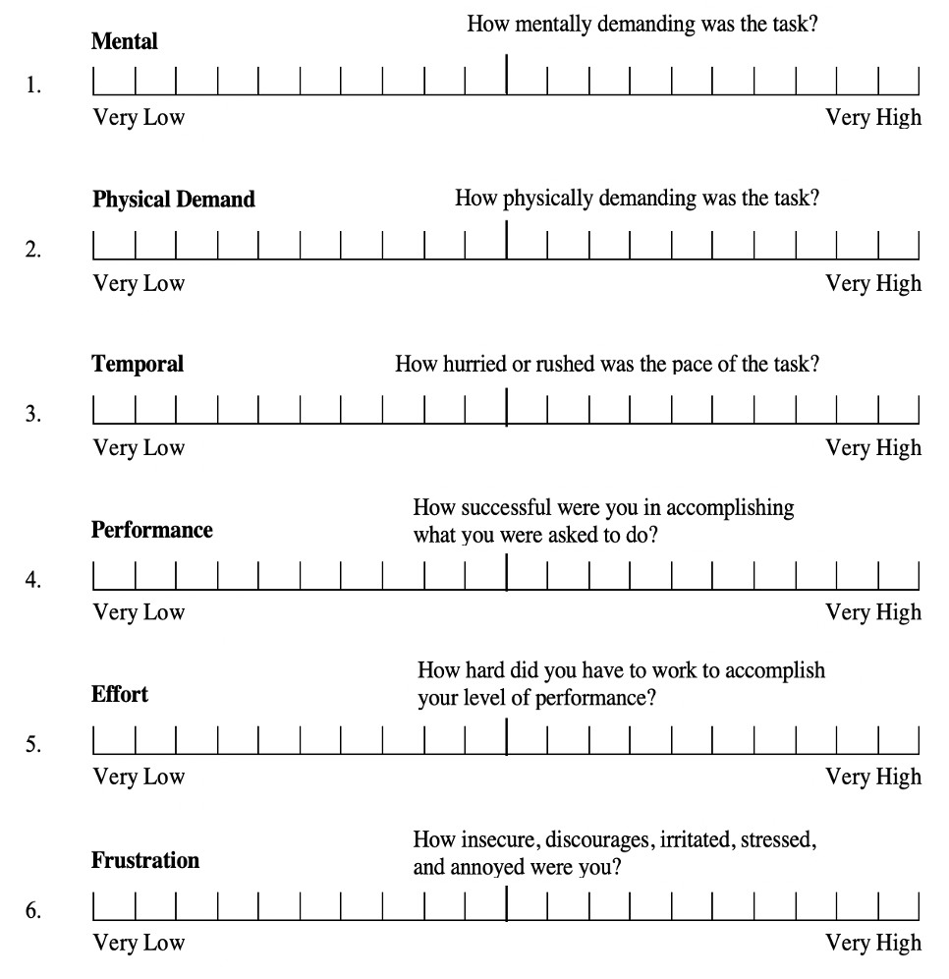
NASA-TLX Questions

Slide 47
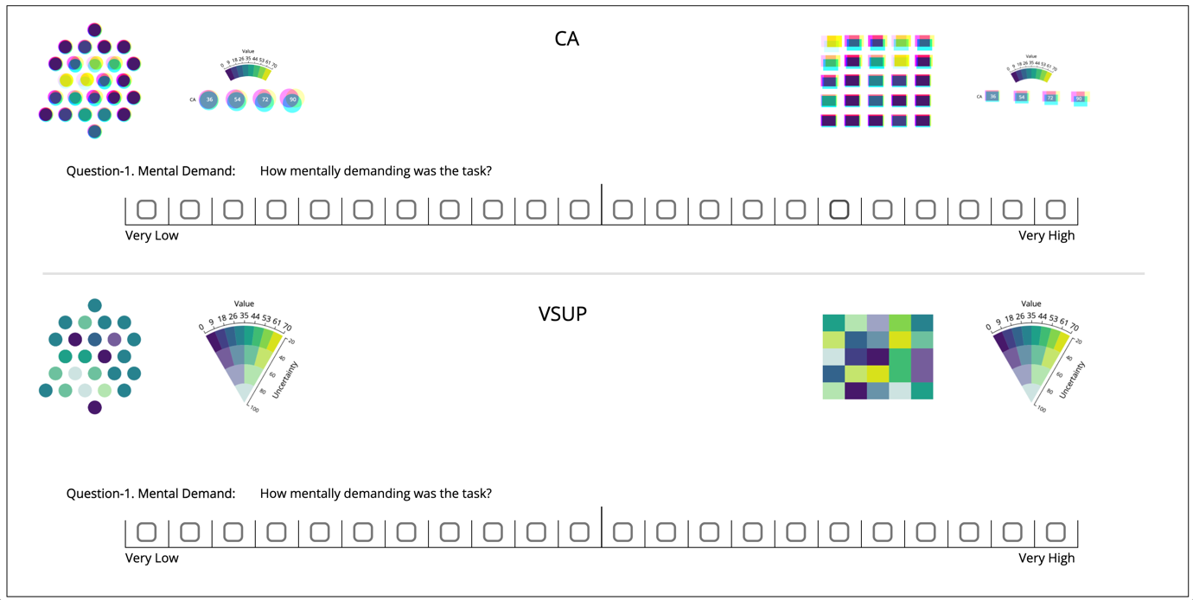
NASA-TLX Question Interface

Slide 48
Results

Slide 49
Quantitative Questionnaire
Groups | N | Mean | Std. Dev. | Variance | Std. Error.
CA + Bubble | 32 | 6.2813 | 1.301 | 1.692 | 0.23
CA + Grid | 32 | 5.5938 | 1.2916 | 1.668 | 0.2283
VSUP + Bubble | 32 | 5.6563 | 1.4053 | 1.975 | 0.2127
VSUP + Grid | 32 | 5.1875 | 1.2032 | 1.456 | 0.2127
ANOVA Data summary
The results of a one-way ANOVA is considered reliable if
Samples are independent
Variances of populations are equal
Response variable is normal

Slide 50
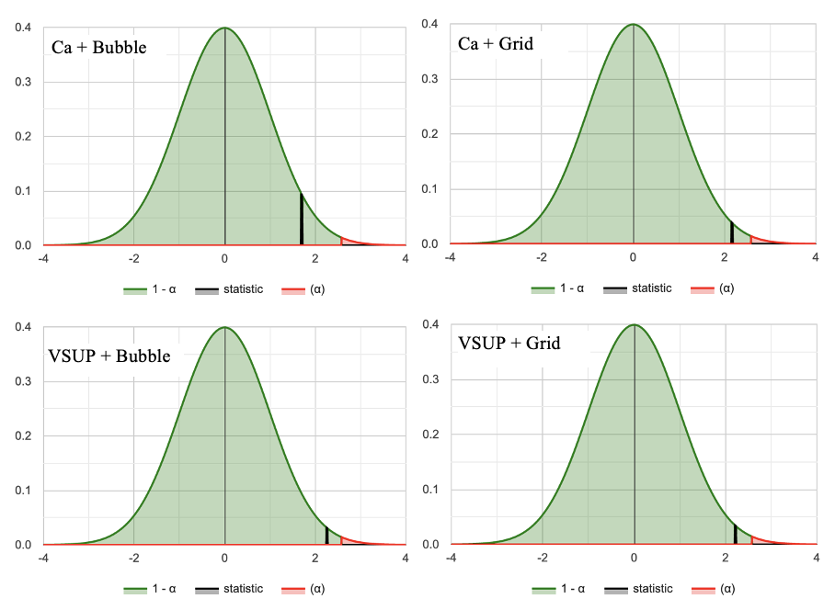
Normality Test
Component | W | P | Status
Ca + Bubble | 0.915 | 0.015 | Normal
Ca + Grid | 0.932 | 0.045 | Normal
VSUP + Bubble | 0.911 | 0.012 | Normal
VSUP + Grid | 0.913 | 0.013 | Normal
Shapiro-Wilk Test
Normal Distributions Graphs

Slide 51
ANOVA Test
Null and Alternative Hypotheses:
Ho: μ1​ = μ2 ​= μ3 ​= μ4​ (Performances were equal for all components)
Ha: Not all means are equal (Performances were not equal for all components)
Source | Degrees of Freedom DF | Sum of Squares SS | Mean Square MS | F-Stat | P-Value
Between Groups | 3 | 19.5875 | 6.5292 | 3.8499 | 0.0113
Within Groups | 124 | 210.2851 | 1.6958
Total | 127 | 229.8726
Test Results Summary

Slide 52
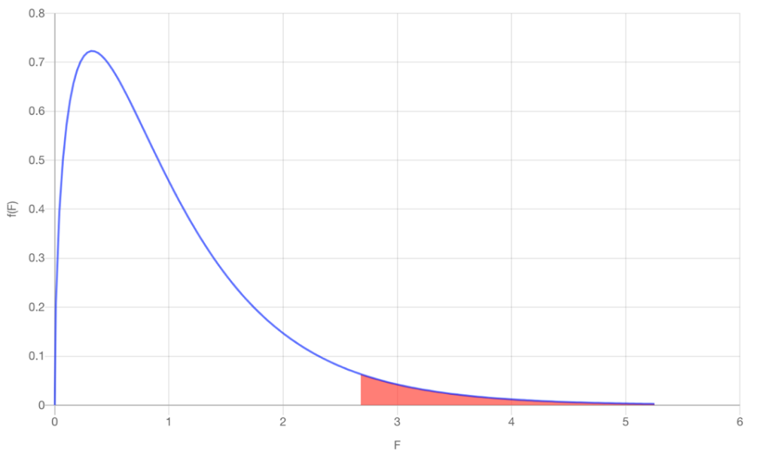
ANOVA Result Analysis
Test Statistics: The computed test statistic F equals 3.8499, which is not in the 95% region of acceptance: [-∞: 2.678].
Decision about null hypothesis: p-value equals 0.0113, [p ( x ≤ F ) = 0.988735 ]. That means, chance of type1 error (rejecting a true H0) is small: 0.0113 (1.13%). Again from sample we see, F = 3.85 > Fc​=2.678, that suggest null hypothesis is rejected
Conclusion: null hypothesis Ho is rejected for α=0.05. In other words, the difference between the averages of some groups is statistically significant. Again, from data summary we found: Means of CA + Bubble significantly higher Means of CA + Grid and VSUP + Bubble are closer Means of VSUP + Grid significantly lower Performance of CA is better than VSUP
Plot of ANOVA Results

Slide 53
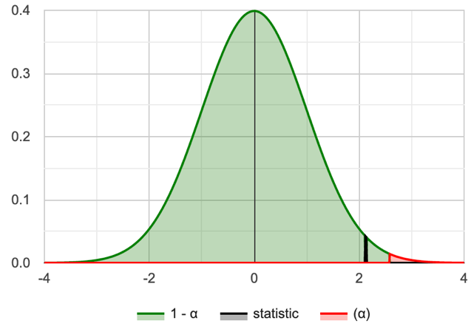
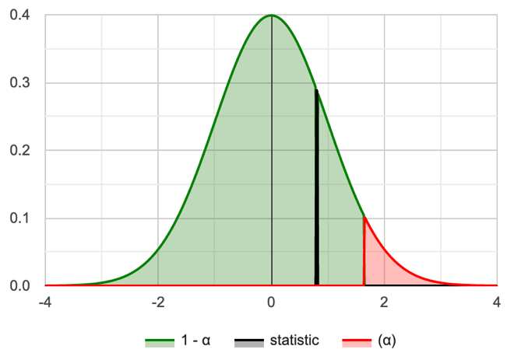
Paired t-test
Group | CA | VSUP
Mean | 5.938 | 5.422
SD | 1.105 | 1.078
SEM | 0.195 | 0.191
N | 32 | 32
Group | CA | VSUP
Skewness | -0.4622 | 0.07107
Kurtosis | -0.8658 | -0.8737
p-value | .017 | 0.017
W | 0.916 | 0.956
Data Summary
Shapiro-Wilk Normality Test
CA and VSUP normal distribution

Slide 54
t-test Results for Questionnaire
Null and Alternative Hypotheses
Ho: μ_{D​​} = (μ1​ - μ2) >= 0 (performance of CA is higher or equal to performance of VSUP) Ha: μ_{D} = ​(μ1​ - μ2) < 0 (performance of CA is less than performance of VSUP)
Rejection Region: R={t : t < −1.696} for critical value t_{c​} = −1.696
Test Statistics: t-statistic = 3.61
P-Value: p = 0.9995
Decision about the null hypothesis:
Based on t-statistic (t = 3.61 ≥ t_{c} ​= −1.696), the null hypothesis is not rejected By P-value approach (p = 0.9995 ≥ 0.05), the null hypothesis is not rejected
Conclusion: Performance of CA is higher to performance of VSUP

Slide 55
Time Utilization (TU)
Shapiro-Wilk normality tests:
For CA: W(32) = 0.959, p = 0.254
For VSUP = W(32) = 0.977, p = 0.716
Group | CA | VSUP
Mean | 8.675 | 9.647
SD | 2.320 | 3.123
SEM | 0.410 | 0.552
N | 32 | 32
Data Summary
Null and Alternative Hypotheses: Ho: μ_{D​​} = (μ1​ - μ2) <= 0 (CA response was equal or faster than VSUP response) Ha: μ_{D} = (μ1​ - μ2) > 0 (CA response was slower than VSUP response)
Rejection Region: R={t : t > 1.696}, for α = 0.05 and t_{c}​ = 1.696
Test Statistics: t-statistic = -2.656
Decision about the null hypothesis: Since t = −2.656 ≤ t_{c} ​= 1.696, the null hypothesis is not rejected Since p = 0.9938 ≥ 0.05, null hypothesis is not rejected
Conclusion: CA response was faster than VSUP response

Slide 56
T-test Results for TU
Null and Alternative Hypotheses
Ho: μ_{D​​} = (μ1​ - μ2) >= 0 (performance of CA is higher or equal to performance of VSUP) Ha: μ_{D} = ​(μ1​ - μ2) < 0 (performance of CA is less than performance of VSUP)
Rejection Region: R={t : t < −1.696} for critical value t_{c​} = −1.696
Test Statistics: t-statistic = 3.61
P-Value: p = 0.9995
Decision about the null hypothesis:
Based on t-statistic (t = 3.61 ≥ t_{c} ​= −1.696), the null hypothesis is not rejected By P-value approach (p = 0.9995 ≥ 0.05), the null hypothesis is not rejected
Conclusion: Performance of CA is higher to performance of VSUP

Slide 57
SUS Results
Group | CA | VSUP
Mean | 60.078 | 61.094
SD | 16.307 | 14.227
SEM | 2.883 | 2.515
N | 32 | 32
The Shapiro-Wilk tests shows that they do not meet normality test with the following results:
For CA: W(32) = 0.913, p = 0.013
For VSUP: W(32) = 0.889, p = 0.003
Score Calculation:
For odd items: subtract one from the user response.
For even-numbered items: subtract the user responses from 5
This scales all values from 0 to 4 (with four being the most positive response).
Add up the converted responses for each user and multiply that total by 2.5.
Range of possible values [0 to 100] instead of [0 to 40]

Slide 58
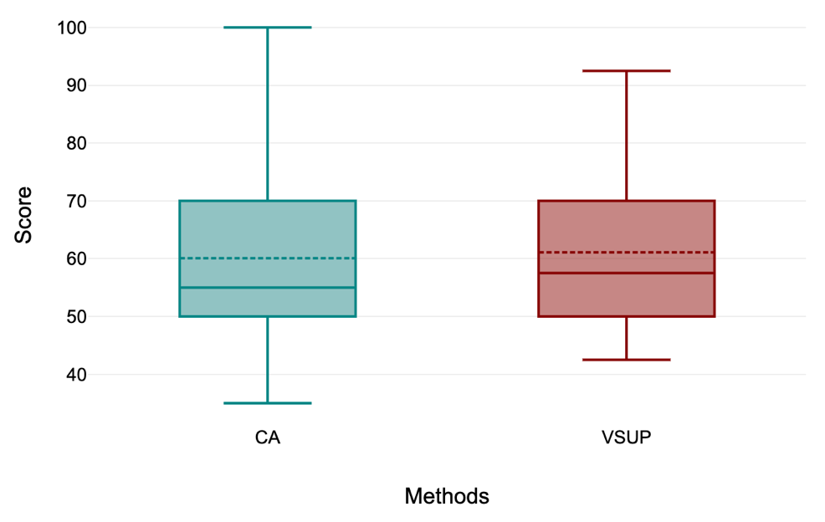
Kruskal-Wallis Test on SUS Data
Null and Alternative Hypotheses
Ho: The samples come from populations with equal medians.
Ha: The samples come from populations with medians that are not all equal.
Rejection Region: R = {χ2: χ2 > 3.841}, for df = 2 – 1 = 1, α=0.05
Test Statistics: H = 0.146
P-Value: 0.702
Decision about the null hypothesis:
Based on H-statistic (χ²=0.146 ≤ χ_{c}2​ = 3.841 ), the null hypothesis is not rejected By P-value approach (p = 0.702 ≥ 0.05 ), the null hypothesis is not rejected
Conclusion: Results do not statistically significantly vary between CA and VSUP.

Slide 59
NASA-TLX Results
Methods | NASA-TLX | Shapiro-Wilk Normality Test (α = 0.05)
 |  | Test Statistic (W) | p-value | Status
CA | Mental Demand | 0.906 | 0.009 | Not normal
 | Physical Demand | 0.914 | 0.014 | Not normal
 | Temporal Demand | 0.948 | 0.128 | Normal
 | Performance | 0.932 | 0.044 | Not normal
 | Effort | 0.942 | 0.085 | Not normal
 | Mental Frustration | 0.916 | 0.017 | Not normal
VSUP | Mental Demand | 0.863 | 0.001 | Not normal
 | Physical Demand | 0.903 | 0.007 | Not normal
 | Temporal Demand | 0.938 | 0.067 | Not normal
 | Performance | 0.887 | 0.003 | Not normal
 | Effort | 0.901 | 0.006 | Not normal
 | Mental Frustration | 0.877 | 0.002 | Not normal
Normality test results

Slide 60
Kruskal-Wallis Test on NASA-TLX Data
Null and Alternative Hypotheses
Ho: The samples come from populations with equal medians.
Ha: The samples come from populations with medians that are not all equal.
NASA-TLX | X2 | P | df | H | Conclusion
Mental Demand | 0.19 | 0.6626 | 1 | 0.19 | Not Rejected
Physical Demand | 0.062 | 0.8038 | 1 | 0.062 | Not Rejected
Temporal Demand | 0.018 | 0.8932 | 1 | 0.018 | Not Rejected
Performance | 3.61 | 0.0574 | 1 | 3.61 | Not Rejected
Effort | 0.062 | 0.8038 | 1 | 0.062 | Not Rejected
Mental Frustration | 0.173 | 0.6772 | 1 | 0.173 | Not Rejected

Slide 61
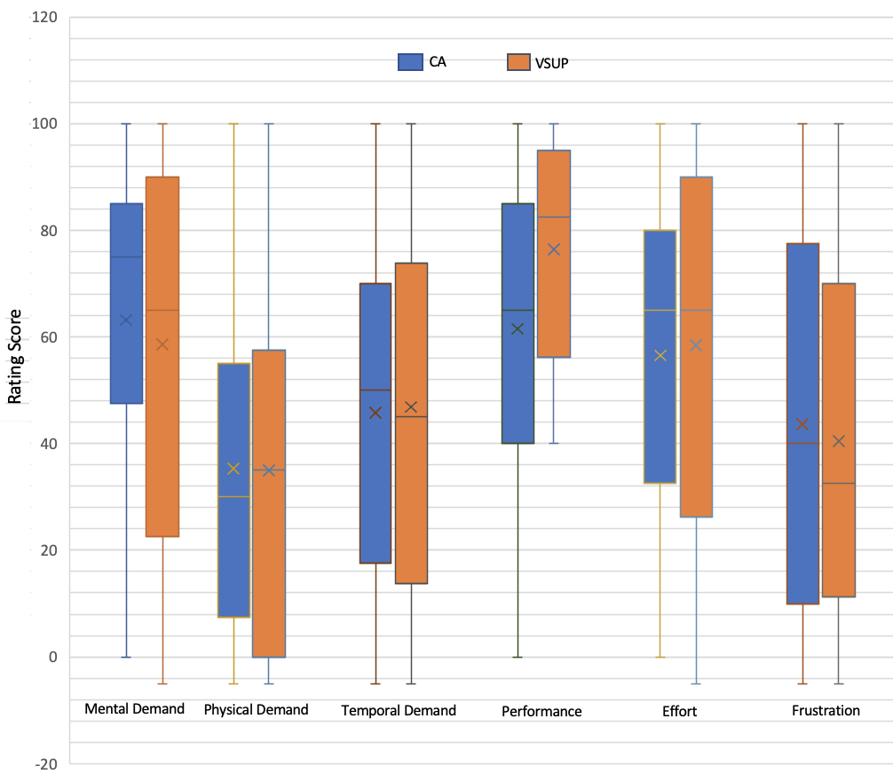
NASA-TLX Results
Conclusion: Although box-plot shows slight differences in medians but the overall results are not statistically significant.
Box Plot of six questions responses

Slide 62
Conclusion
User performance and perception for CA statistically surpasses VSUP.
CA is faster than VSUP in terms of task completion time by the users.
Subjective assessments show that both CA and VSUP are statistically similar.

Slide 63
Future work
A further study could be conducted with more levels uncertainties for instance, with 8 levels instead of 4 levels of uncertainties.
The role of CA might also be explored and studied with animated visualization.
Other future work may refine and expand upon some of our other experimental designs Starfish streamgraph layout.

Slide 64
Questions?

Slide 65
References
Michael Correll, Dominik Moritz, Jeffrey Heer. Value-Suppressing Uncertainty Palettes. Proceedings of the 2018 CHI Conference on Human Factors in Computing Systems. April 2018. Paper No.: 642 Pages 1–11.
Song, Xin; Xiao, Jun PhD; Deng, Jiang PhD; Kang, et al. Time series analysis of. influenza incidence in Chinese provinces from 2004 to 2011. Received March 1, 2016, Accepted May 20, 2016, Medicine: June 2016 - Volume 95 - Issue 26 - p e3929
Christophorus Beneditto, Aditya Satrio et al. Time series analysis and forecasting of coronavirus disease in Indonesia using ARIMA model and PROPHET, https://doi.org/10.1016/j.procs.2021.01.036
Stéfan van der Walt and Nathaniel Smith. 2015. Mpl colormaps. https://bids.github.io/colormap/, (2015).
Keppel, Geoffrey: Design and Analysis, 3rd Edition. Prentice-Hall.

Slide 66
References
M. K. Johnson & H. Farid. 2006. Exposing digital forgeries through chromatic aberration. Multimedia and security, Geneva, Switzerland, 48-55
Aasim Kamal · Parashar Dhakal, et al. Recent advances and challenges in uncertainty visualization: a survey. May 2021, Journal of Visualization 24(5):1-30.
Shapiro, S. S.; Wilk, M. B. (1965). "An analysis of variance test for normality (complete samples)". Biometrika. 52 (3–4): 591–611. Stéfan van der Walt and Nathaniel Smith. 2015. Mpl colormaps. https://bids.github.io/colormap/, (2015).
Henning Griethe et al. The Visualization of Uncertain Data: Methods and Problems. Computer Graphics, 18051 Rostock, Germany. January 2006, 2,988 reads, 36 publications, 262 citations.
Pang, A., Wittenbrink, C., Lodha., S.: Approaches to uncertainty visualization. The Visual Computer 13(8), 370–390 (1997).
R. Finger and A. M. Bisantz. Utilizing graphical formats to convey uncertainty in a decision-making task. Theoretical Issues in Ergonomics Science, 3(1):1–25, 2002

Slide 67
References
K. Koh, B. Kim & J. Seo. 2014. Effect of lateral chromatic aberration for chart reading in information visualization on display devices. Advanced Visual Interfaces. Como, Italy, 289-292
M. K. Johnson & H. Farid. 2006. Exposing digital forgeries through chromatic aberration. Multimedia and security, Geneva, Switzerland, 48-55.
Deitrick, S., Edsall, R.: The influence of uncertainty visualization on decision making: An empirical evaluation. In: Progress in Spatial Data Handling, pp. 719–738. Springer Berlin Heidelberg (2006).
Aasim Kamal · Parashar Dhakal, et al. Recent advances and challenges in uncertainty visualization: a survey. May 2021, Journal of Visualization 24(5):1-30.

